Slide 1
Classification of ML
ML @ Lecture 2

Slide 2
How ML Work
Machine learning is the brain where all the learning takes place. The way the machine learns is similar to the human being. Humans learn from experience. The more we know, the more easily we can predict.
By analogy, when we face an unknown situation, the likelihood of success is lower than the known situation. Machines are trained the same. To make an accurate prediction, the machine sees an example. When we give the machine a similar example, it can figure out the outcome.
However, like a human, if its feed a previously unseen example, the machine has difficulties to predict.

Slide 3
How ML Work
The core objective of machine learning is the learning and inference.
First of all, the machine learns through the discovery of patterns. This discovery is made thanks to the data. One crucial part of the data scientist is to choose carefully which data to provide to the machine.
The list of attributes used to solve a problem is called a feature vector. A feature vector as a subset of data that may used to tackle a problem.

Slide 4
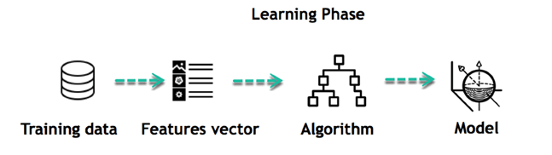
How ML Work
The machine uses some fancy algorithms to simplify the reality and transform this discovery into a model. Therefore, the learning stage is used to describe the data and summarize it into a model.

Slide 5
How ML Work
The machine uses some fancy algorithms to simplify the reality and transform this discovery into a model. Therefore, the learning stage is used to describe the data and summarize it into a model.
For instance, the machine is trying to understand the relationship between the wage of an individual and the likelihood to go to a fancy restaurant. It turns out the machine finds a positive relationship between wage and going to a high-end restaurant: This is the model

Slide 6
How ML Work (Summary)
Define a question
Collect data
Visualize data
Train algorithm
Test the Algorithm
Collect feedback
Refine the algorithm
Loop 4-7 until the results are satisfying
Use the model to make a prediction
Once the algorithm gets good at drawing the right conclusions, it applies that knowledge to new sets of data

Slide 7
Classification of Machine Learning
• Supervised Learning
• Unsupervised Learning
• Reinforcement Learning

Slide 8
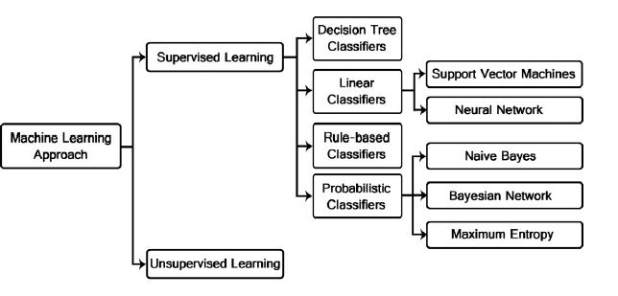
Classifications of Supervised and unsupervised

Slide 9
Supervised Learning
In a supervised learning model, the algorithm learns on a labeled dataset, providing an answer key that the algorithm can use to evaluate its accuracy on training data.
Supervised learning is the machine learning task of learning a function that maps an input to an output based on example input-output pairs. It infers a function from labeled training data consisting of a set of training examples.

Slide 10
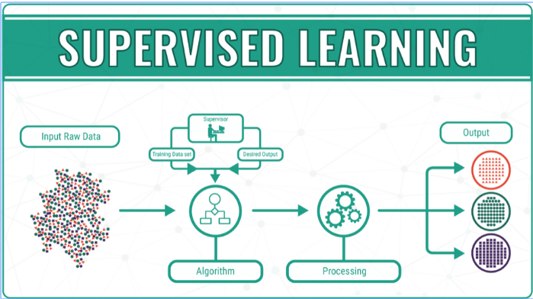
Supervised Learning

Slide 11
Why supervised learning important!
Supervised learning allows you to collect data or produce a data output from the previous experience.
Helps you to optimize performance criteria using experience
Supervised machine learning helps you to solve various types of real-world computation problems.

Slide 12
Unsupervised Learning
Unsupervised learning is a machine learning technique, where you do not need to supervise the model. Instead, you need to allow the model to work on its own to discover information. It mainly deals with the unlabelled data
Unsupervised learning algorithms allow you to perform more complex processing tasks compared to supervised learning. Although, unsupervised learning can be more unpredictable compared with other natural learning deep learning and reinforcement learning methods.

Slide 13
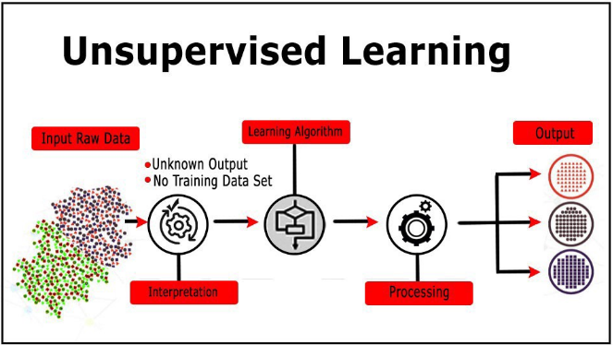
Unsupervised Learning

Slide 14
Why Unsupervised Learning?
Unsupervised machine learning finds all kind of unknown patterns in data.
Unsupervised methods help you to find features which can be useful for categorization.
It is taken place in real time, so all the input data to be analyzed and labeled in the presence of learners.
It is easier to get unlabeled data from a computer than labeled data, which needs manual intervention.

Slide 15
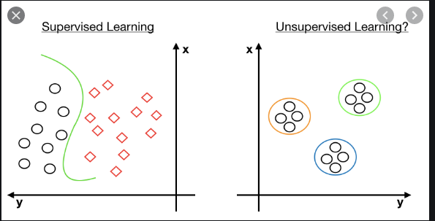
Supervised vs Unsupervised

Slide 16
Reinforcement Learning
Reinforcement learning is an area of Machine Learning. It is about taking suitable action to maximize reward in a particular situation. It is employed by various software and machines to find the best possible behavior or path it should take in a specific situation.
Reinforcement learning differs from the supervised learning in a way that in supervised learning the training data has the answer key with it so the model is trained with the correct answer itself whereas in reinforcement learning, there is no answer but the reinforcement agent decides what to do to perform the given task.
In the absence of a training dataset, it is bound to learn from its experience

Slide 17
Reinforcement Learning ..Key points
Reinforcement learning is an area of Machine Learning. It is about Input: The input should be an initial state from which the model will start
Output: There are many possible output as there are variety of solution to a particular problem
Training: The training is based upon the input, The model will return a state and the user will decide to reward or punish the model based on its output.
The model keeps continues to learn.
The best solution is decided based on the maximum reward.

Slide 18
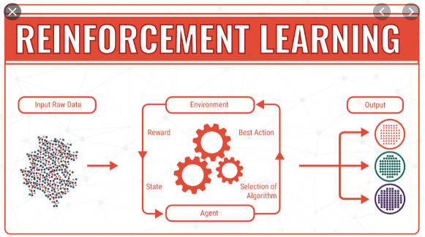
Reinforcement Learning

Slide 19
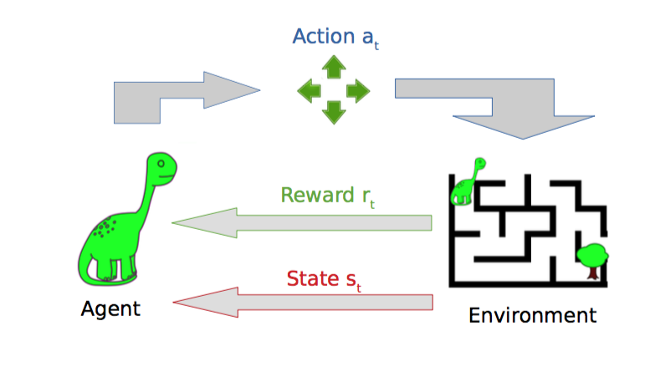

Slide 20
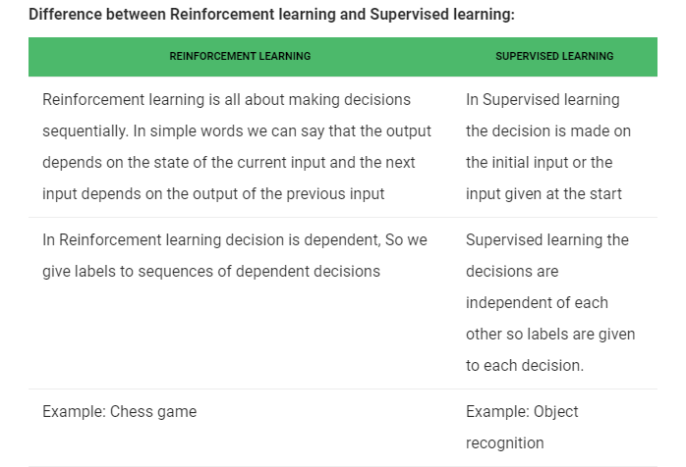
Supervised vs Reinforcement Learning

Slide 21
Variations of Machine Learning
Unsupervised learning: Learning without output values (data exploration, e.g. clustering).
Query learning: Learning where the learner can query the environment about the output associated with a particular input.
Reinforcement learning: Learning where the learner has a range of actions which it can take to attempt to move towards states where it can expect high rewards.
Batch vs. online learning: All training examples at once or one at a time (with estimate and update after each example).

Slide 22
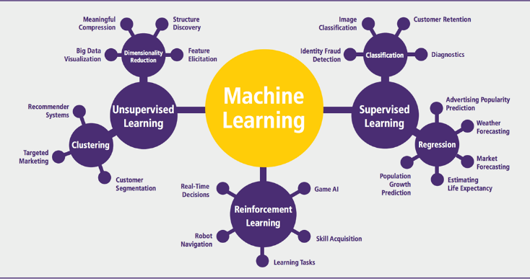
Area of Machine Learning Algorithms

Slide 23
Quiz 10 Marks
9-3-2021

